Slide 1
Predicting the Expected Graduate & Increasing the number of Students in Saudi Arabia
Aljohara saad balghonaim
jsbksa@gmail.com
05039896808.
SADAIA BOOTCAMP T5

Slide 2
Table of Content
Introduction
Data sources
Summary
Visualizations
Algorithms
Tools
Design Introduction

Slide 3
Introduction
Introduction
Education constitutes a significant and critical factor in human resources development, increasing people knowledge and competencies, and ensuring nation economic prosperity. The main objective of education institute and one of its biggest challenges is to provide quality education to its students.
Goal
This project is aimed for answer the below Questions:
What the expected students Graduate?
How the Increasing students Number by gender (Female, Male )?

Slide 4
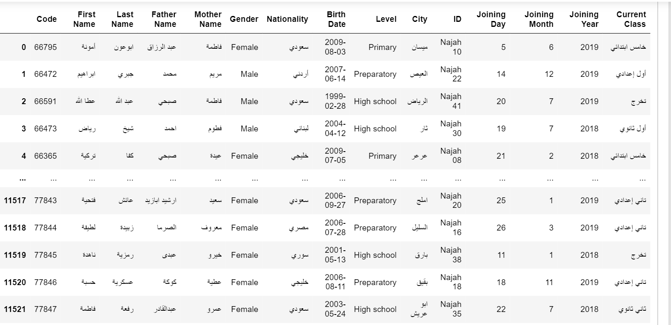
Data sources
From the Dataset I have
15 Features
11522 Observations

Slide 5
Summary
We predicting that 569 Student will be graduate in 2020 to be prepare a sets for University.
The numbers of female start increasing to reach the highest number of females in 2018 than 2017 by 1818.
The numbers of Male start increasing to reach the highest number of male in 2018 than 2017 by 805

Slide 6
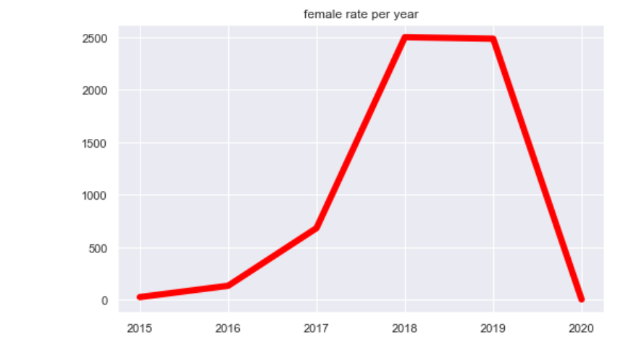
Predicting the Increasing student’s Number (Female )
The numbers of female start increasing to reach the highest number of females in 2018 & 2019 then in 2020 the line fall down to 5835 female the number of female is increasing by years because the condition of COVID 19

Slide 7
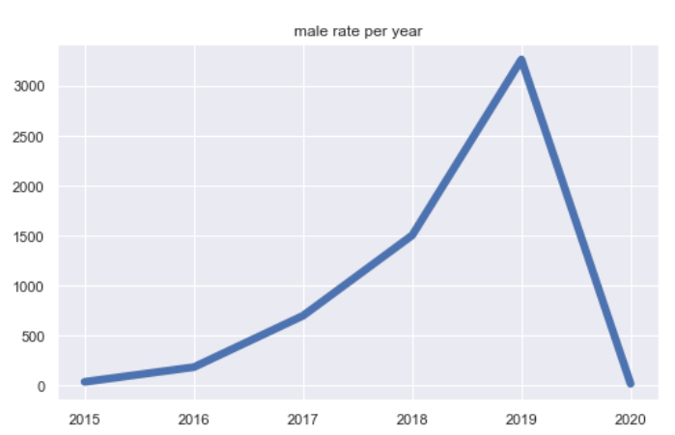
Predicting the Increasing student’s Number (male )
The numbers of Male start increasing to reach the highest number of Male in 2019 then in 2020 the line fall down to 5689 male the number of male is increasing by years
because the condition of COVID 19

Slide 8
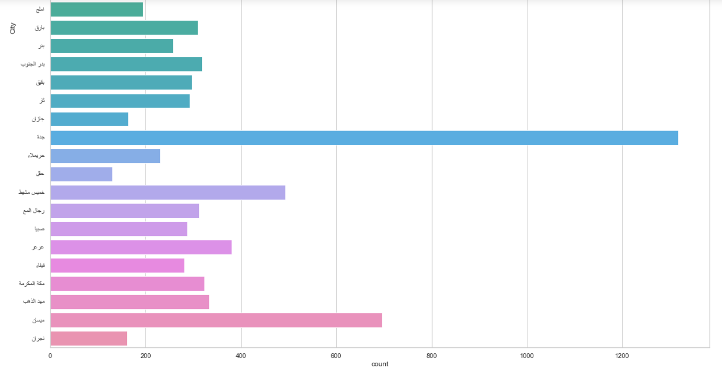
Students Number per city

Slide 9
Algorithms
In the Project we have been used many Algorithms models for training , Validated and testing the score model performance.
Linear Regression validation Score 100% .
Ride Regression validation Score 100%.
Degree polynomial Regression validation Score 100%.
Linear Regression Test Score 100%.
Decision Tree Score 100%.
Random Forest Score 100%.

Slide 10
Tools
Jupiter Notebook.
Panda & Numpy library.
Matplotlib.pyplotLinear & seaborn.
Sklearn.linear_model
Sklearn.model_selection
Sklearn.preprocessing.
Sklearn.tree.
sklearn.ensemble..

